Slide 1

End-to-End Data Pipeline for Sales and Business Performance
Multi-Tool Enterprise Analytics and Visualization Project
Objective: Simulate a real enterprise data lifecycle from raw telemetry to executive dashboards across multiple platforms.

Slide 2
Team Roles and Responsibilities
Abdelrahman Salah
Ziad Moemen
1
Project Lead and Data Engineer
SQL Database Administrator
1
Pipeline engineering
Handling data corruption
Power BI and Tableau dashboards
Main GitHub repository
2
Setting up the MySQL database
Raw DDL scripts
Cleaning the target table
Raw ERD diagram
Adam Anwer
Ahmed Mohamed Rabie
Power Query and Excel Specialist
Python Data Engineer
3
4
Cleaning product and Reseller files using Pandas
Handling missing values
Removing duplicates
Jupyter documentation
3
Cleaning region files, sales person, and sales person region files
Designing the Excel dashboard
Ziad Abdelraouf
SQL Cleaner and Integrator
5
Cleaning the main sales table using SQL
Merging the Star Schema
Performing exploratory data analysis (SQL EDA)

Slide 3
Project Structure and Pipeline Workflow
1
2
3
4
Stage 1: Raw Layer Ingestion
Stage 2: Multi-tool ETL Cleaning
Stage 3: Data Warehouse Integration
Stage 4: Exploratory Data Analysis (EDA)
Data corruption originating in Google Colab and migrated to MySQL Workbench.
Transforming distributed data using Power Query, Python (Pandas), and SQL.
Building a clean relational star schema with PK/FK constraints.
Advanced analytical SQL queries (aggregations, window functions, DENSE_RANK).
5
Stage 5: Multi-platform Visualization
Interactive dashboards built across Power BI, Tableau, and Excel.

Slide 4

Issue Tracking and Data Cleaning Log
Sales Table:
Negative quantities and price outliers were resolved using SQL ABS() logic and validation thresholds.
Products and Vendors Table:
Leading/trailing spaces were removed (str.strip()), and records were deduplicated in Python.
Region and Sales Representatives Table:
Structural text trimming, explicit type conversion, and validation in Power Query were applied.
Targets Table:
Missing values were inferred using COALESCE and standard period formatting in MySQL.

Slide 5
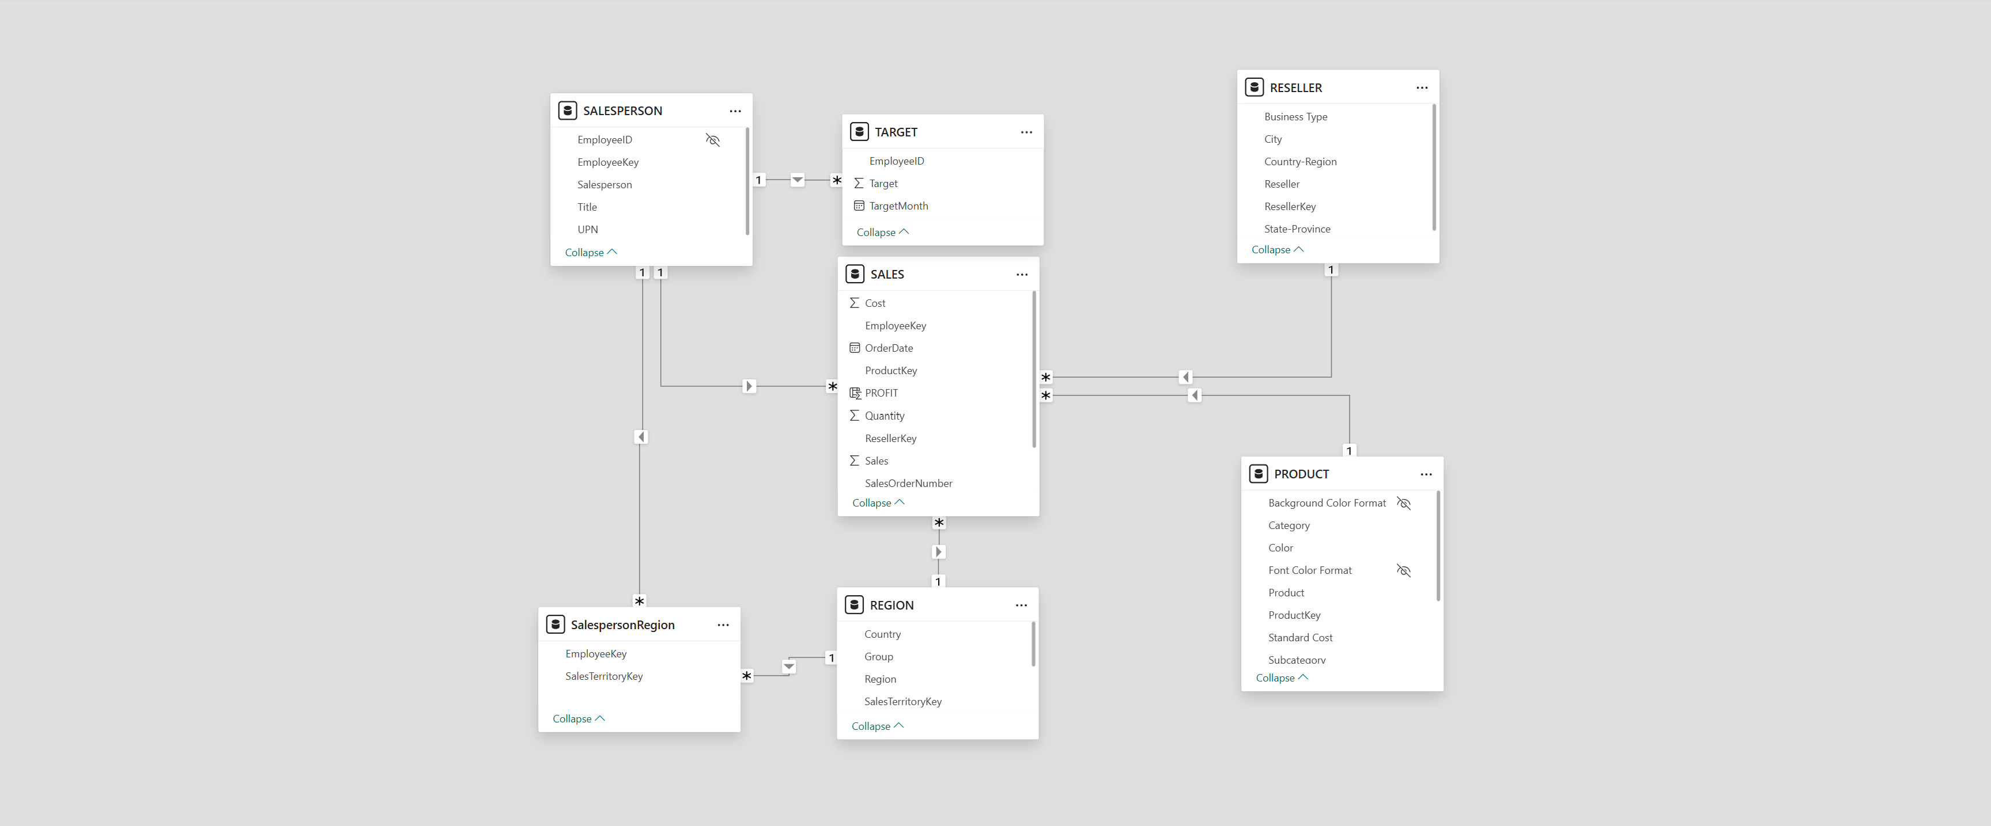
Database Engineering (Raw ERD vs. Clean Star Schema)
Data modeling: moving from a fragmented raw staging layer to a fully structured star schema
Schema design: a central fact table (sales) connected to dimension tables (product, region, reseller, salesperson, targets)
Visual reference: side-by-side ERD screenshots showing the raw staging layer and the final clean star schema structure

Slide 6
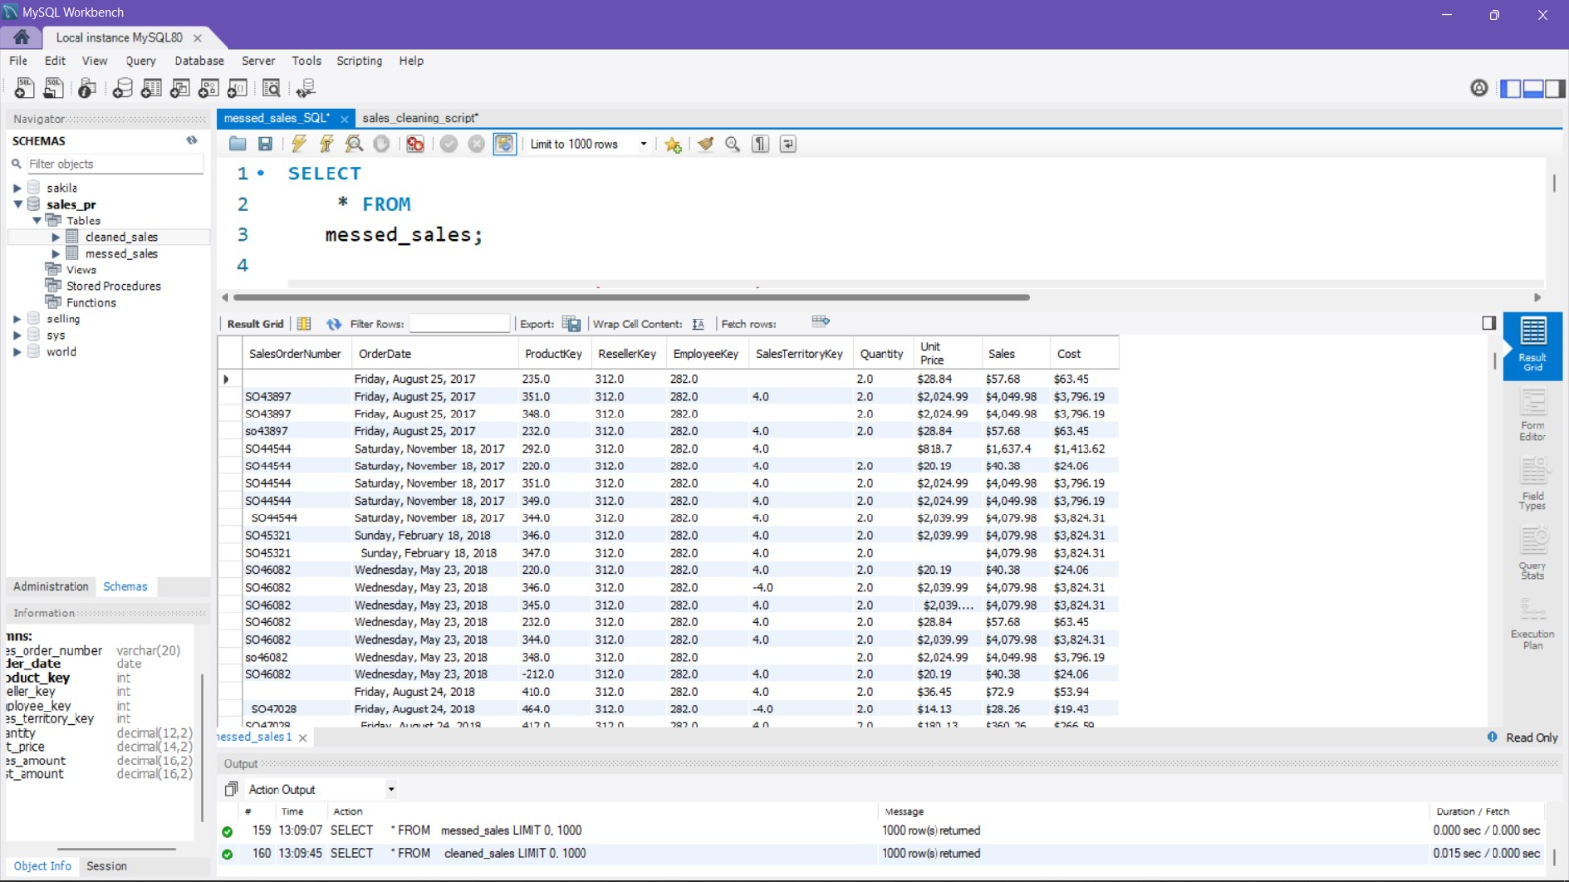
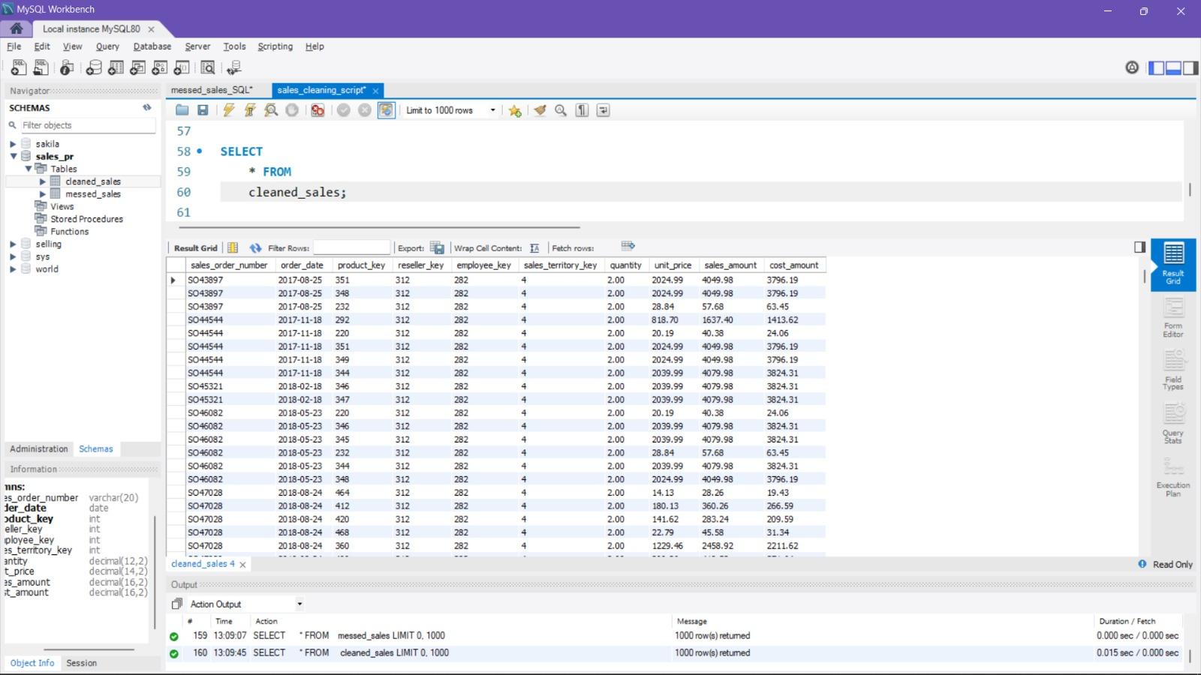
Exploratory Data Analysis (SQL Queries and Results)
Data modeling: moving from a fragmented raw staging layer to a fully structured star schema
SQL Code:

Slide 7
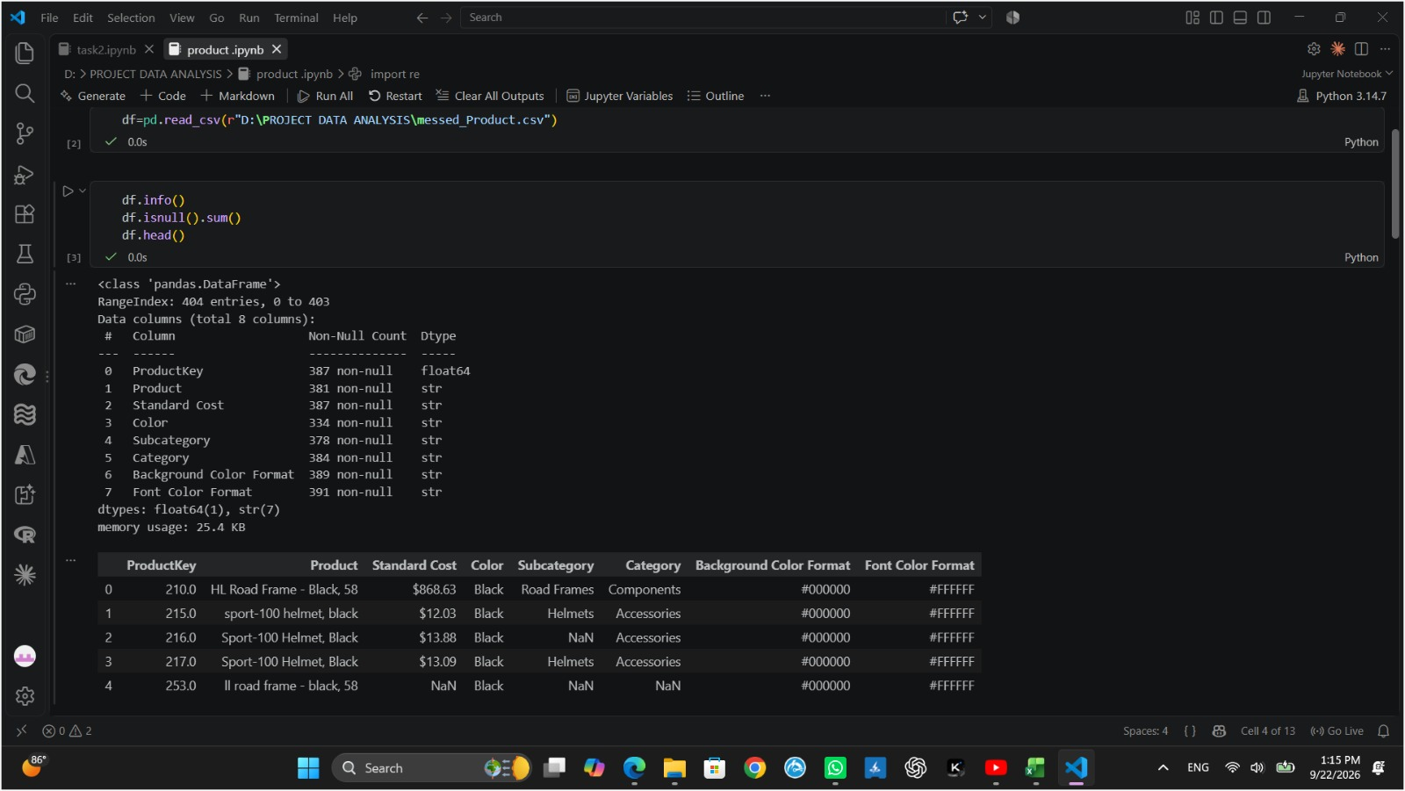
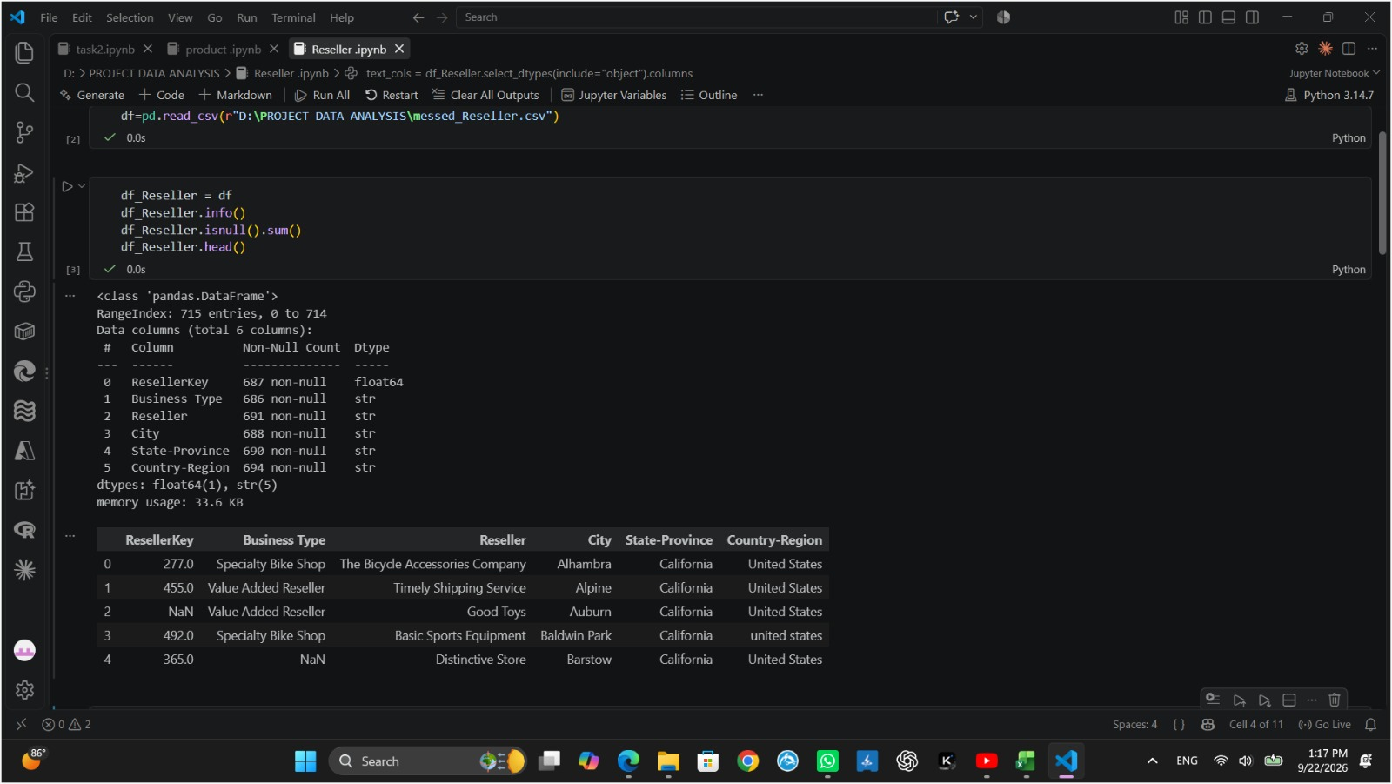
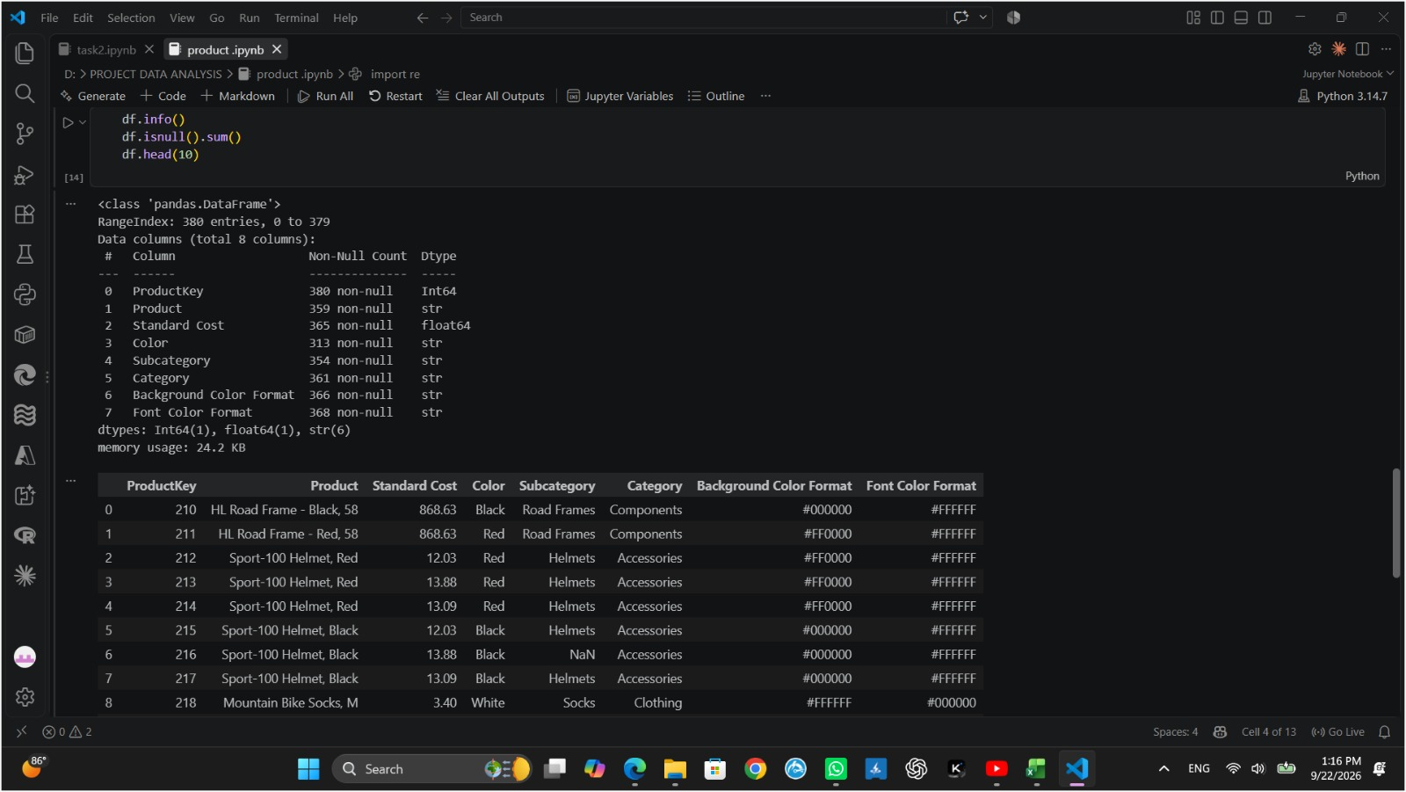
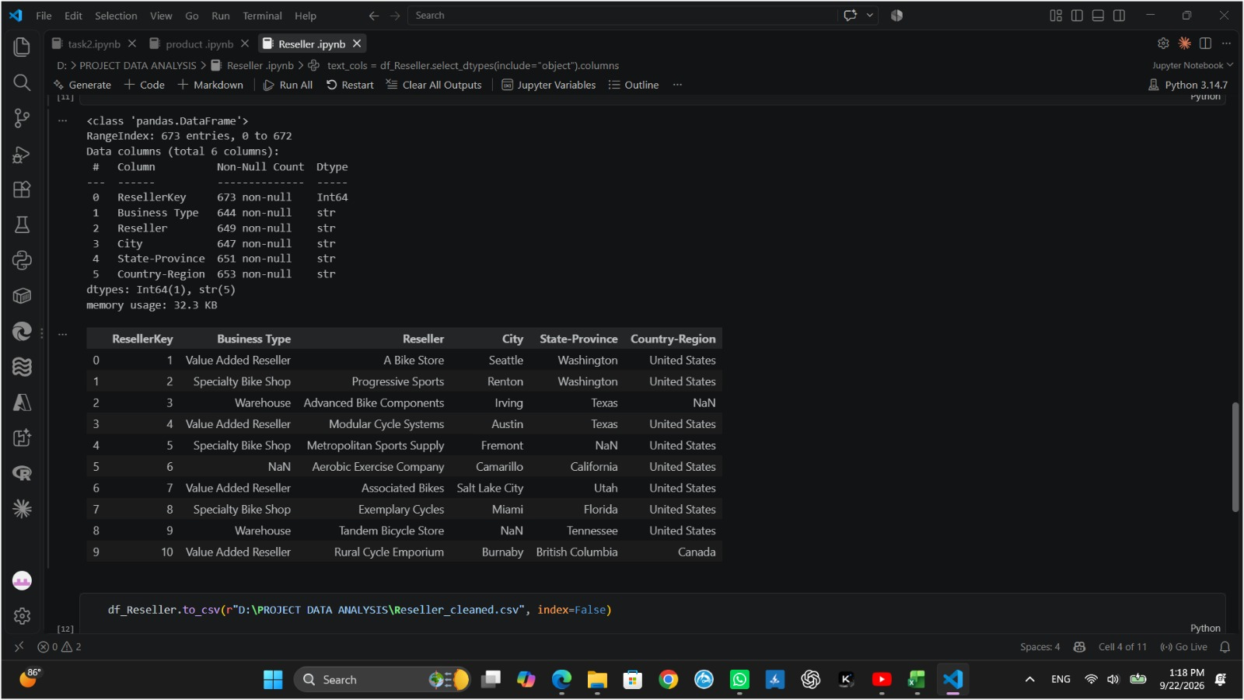
Python Data Engineering & Synthetic Data Generation
SYNTHETIC GENERATION
CLEANING & TRANSFORMATION
Stress-Testing the Pipeline
Pandas & NumPy Processing
Python scripts running in Google Colab generate raw sales datasets with deliberately injected missing values, duplicates, and invalid data types — designed to push pipeline resilience to its limits before any real data flows through.
Null imputation across sparse fields
Deduplication via drop_duplicates()
Regex text trimming with str.strip()
Data type enforcement before staging

Slide 8
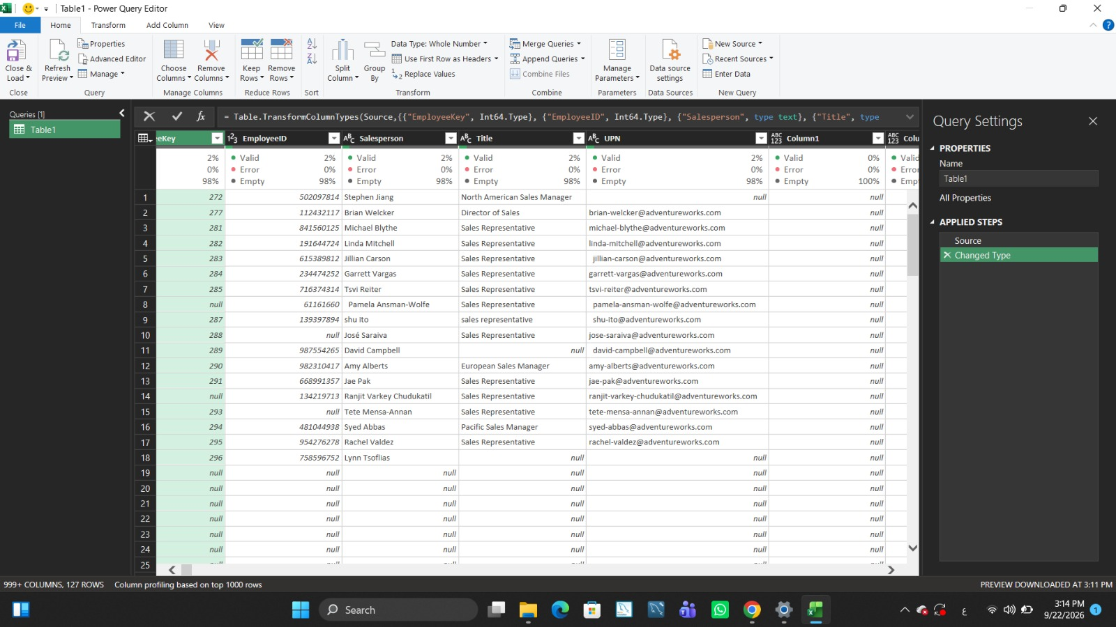
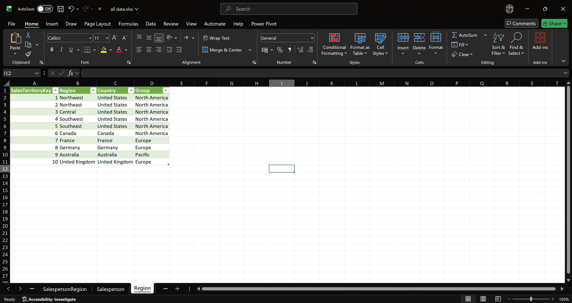
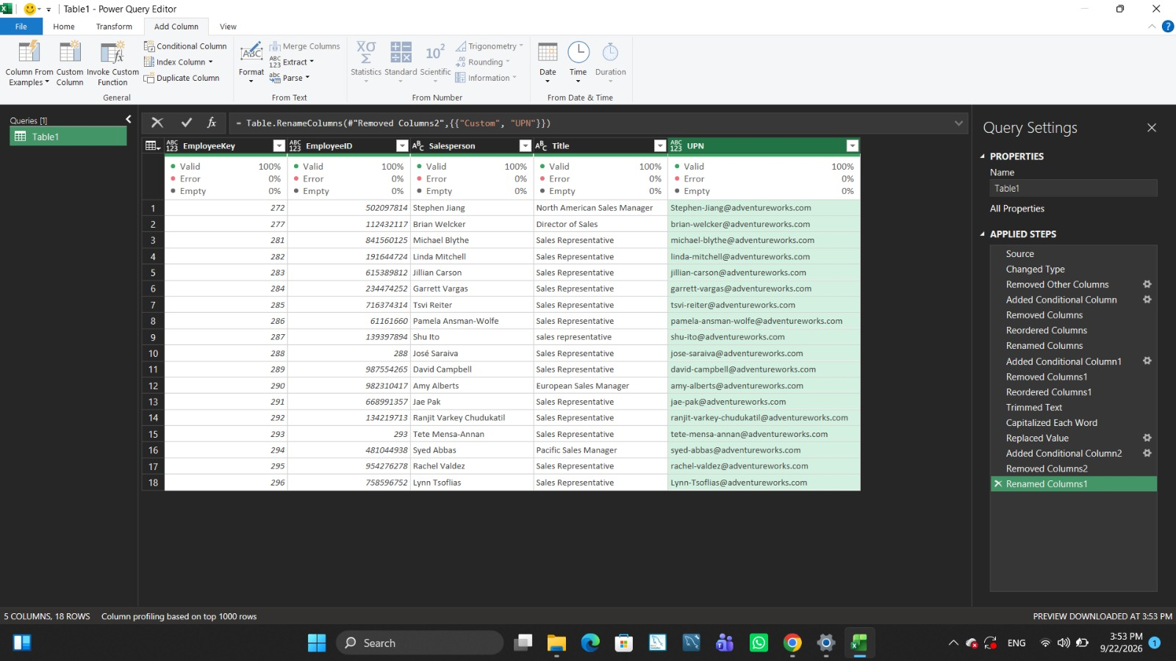
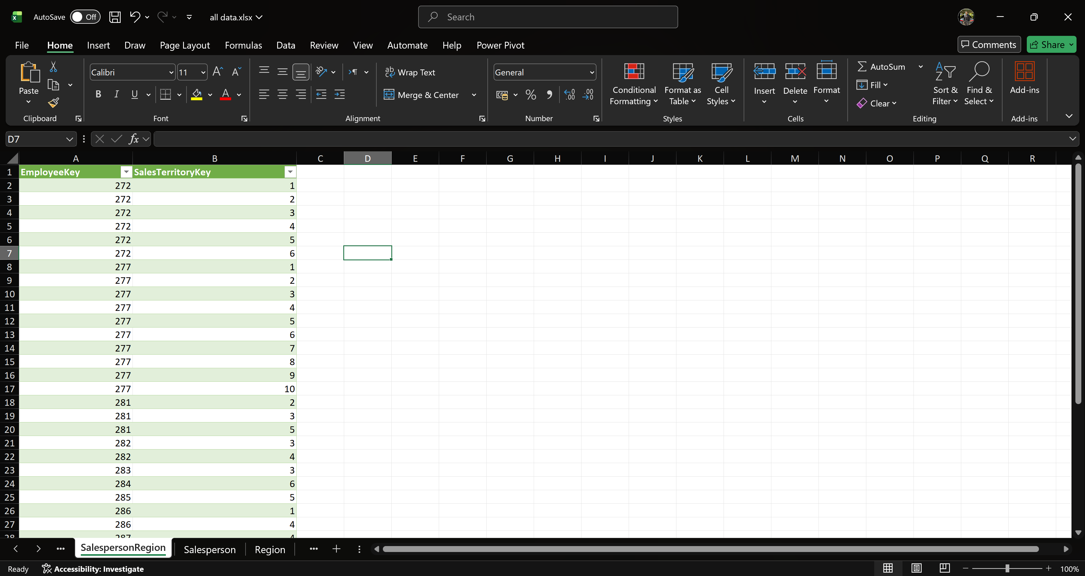
Excel Executive Summary & Dynamic Reporting
Power Query (ETL & Data Cleaning):
Extracted and ingested raw data, setting up an automated ETL pipeline.
Performed rigorous data transformation, including merging/appending tables, handling null values, and profiling columns.
Standardized column data types and applied custom logic using conditional columns.
Excel (Executive Summaries):
Built structured reporting layers and dynamic Pivot Tables on top of the transformed Power Query outputs.
Configured interactive Slicers and KPIs for quick, high-level business insights.

Slide 9
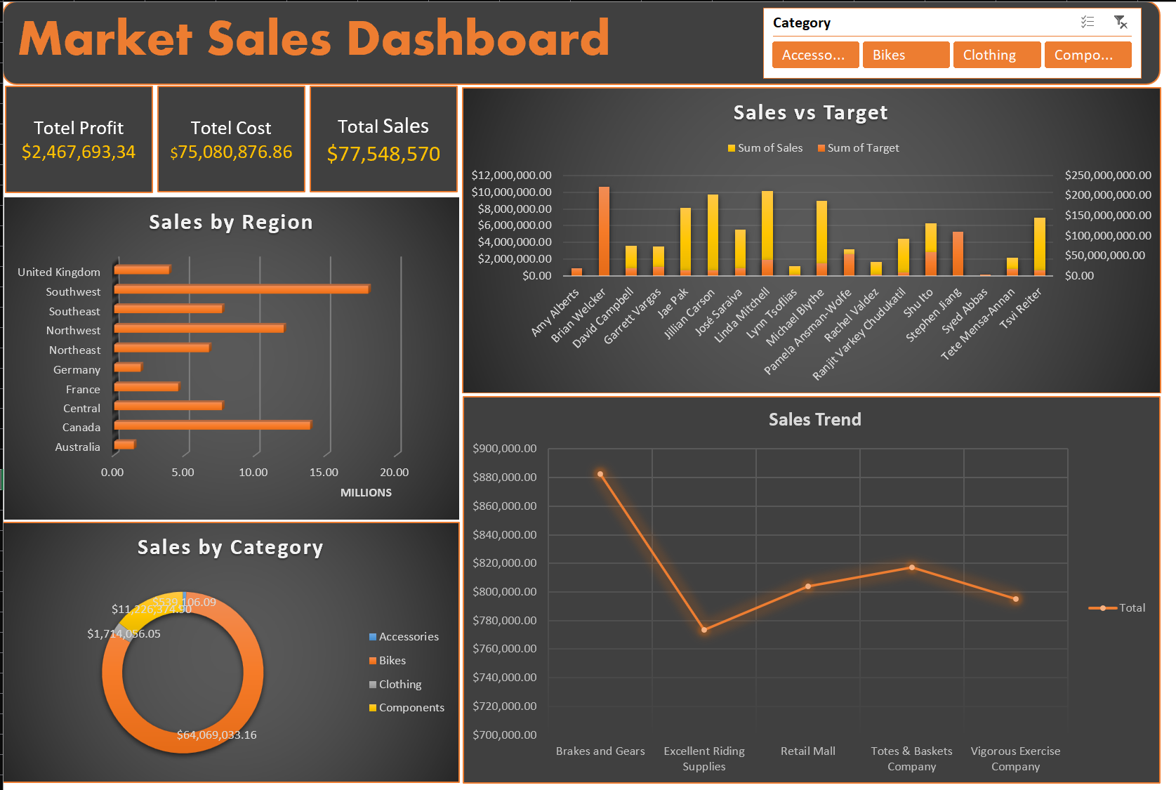
Interactive Excel Dashboard
Tool: Microsoft Excel
Features:
Pivot Tables
Dynamic Pivot Charts
Timeline Slicers
Conditional Formatting
Focus: Operational metrics and sales performance overview
Visual Reference: Excel dashboard screenshots showing quick benchmarking analytics

Slide 10
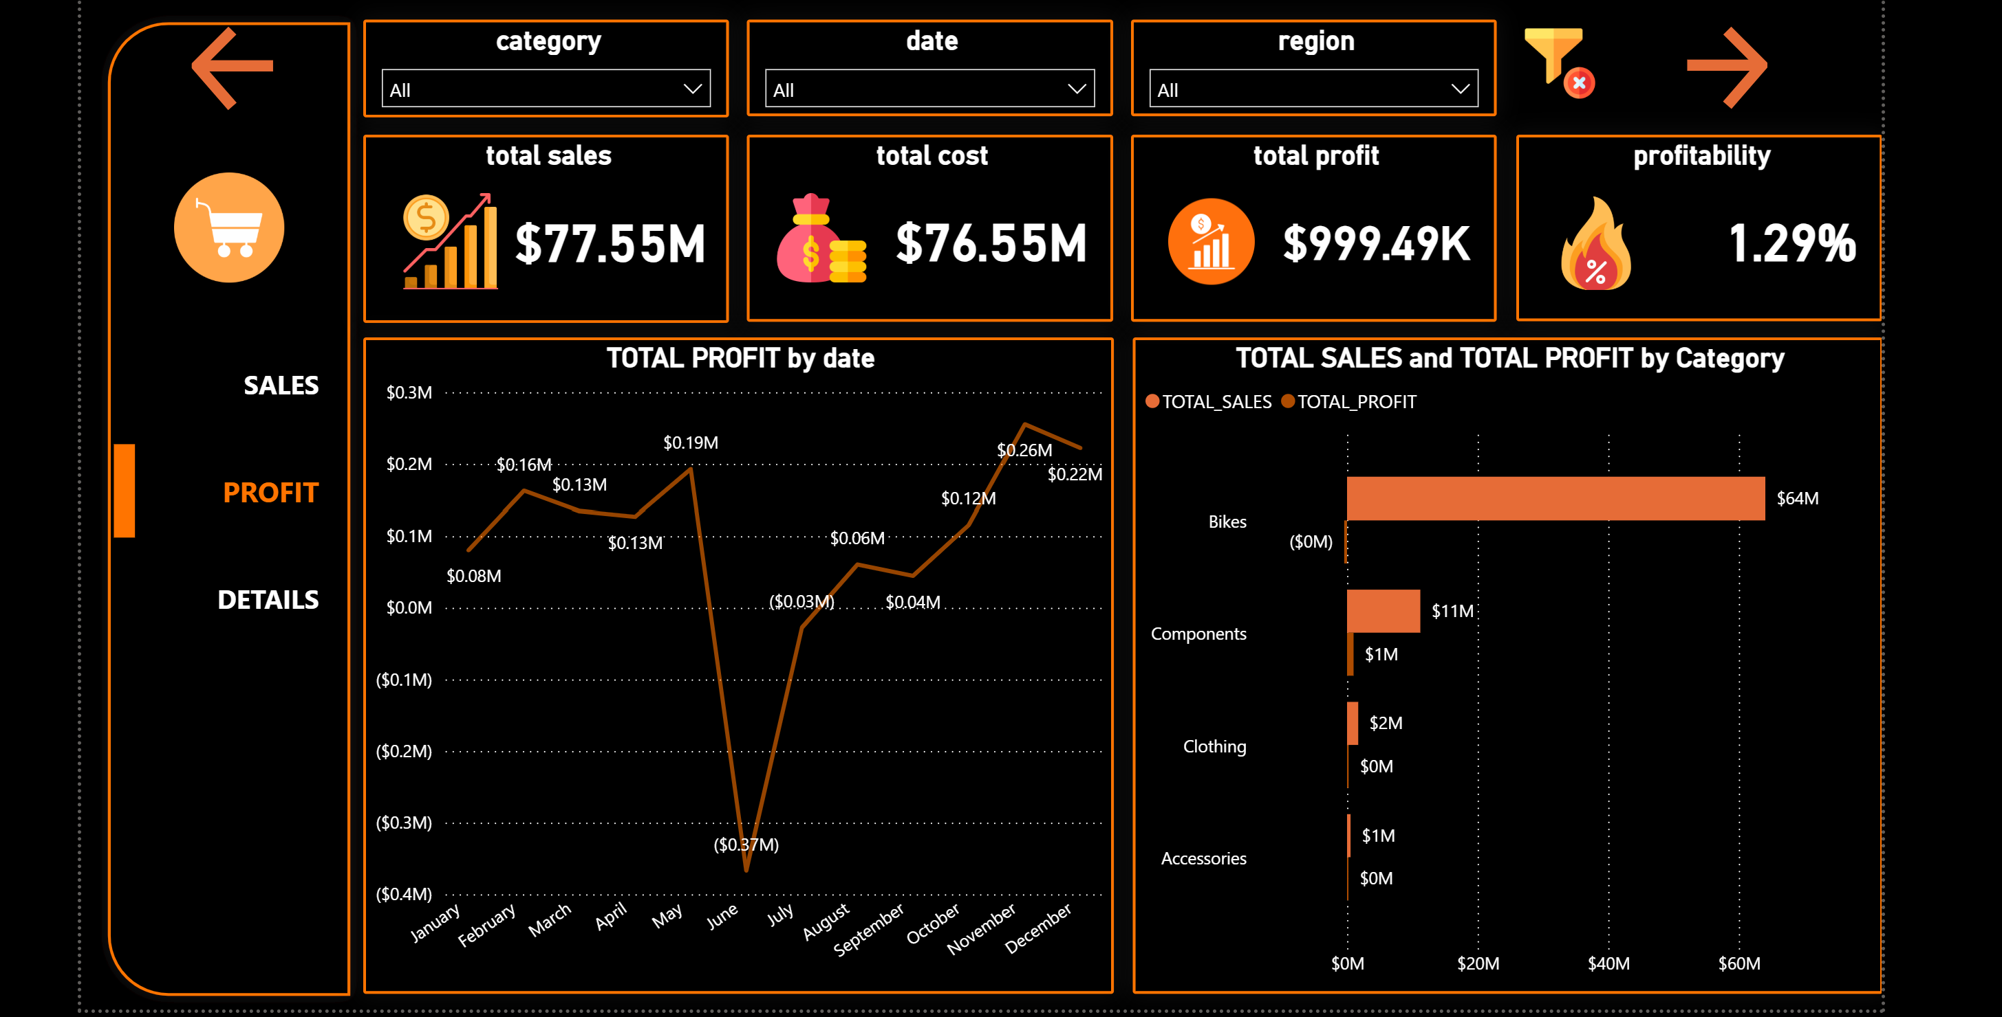
Power BI Interactive Dashboard
Tool: Microsoft Power BI Desktop
Features:
Focus: Executive performance summary and high-level KPI tracking
Visual Reference: Power BI dashboard screenshots showing interactive elements and real-time data insights
Advanced DAX measures
Relational data modeling
Dynamic slicers, and cross-filtering visuals

Slide 11
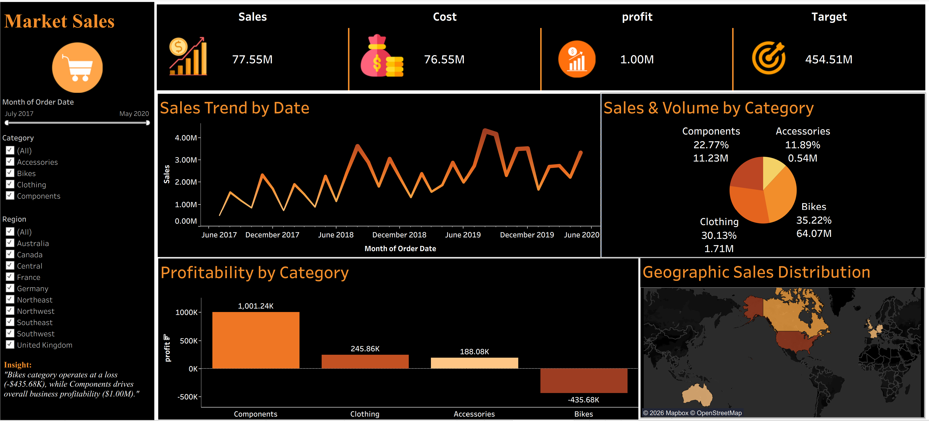
Tableau Interactive Dashboard
Tool: Tableau Public
Features:
Focus: In-depth product performance and geographic sales analytics
Visual Reference: Tableau dashboard screenshots and a public link for stakeholder access
Interactive worksheets
Dashboard actions
Dynamic filters, and parameter controls

Slide 12
Strategic Business Recommendations and Final Deliverables
Business Insights: Strategic recommendations derived from multi-platform data analysis to improve sales performance
Project Final Deliverables:
1
2
3
4
Complete GitHub repository link with full project documentation
MySQL DDL scripts for database setup and schema creation
Python Jupyter notebooks for the data engineering workflow
Power BI, Tableau, and Excel dashboard file assets

